Slide 1
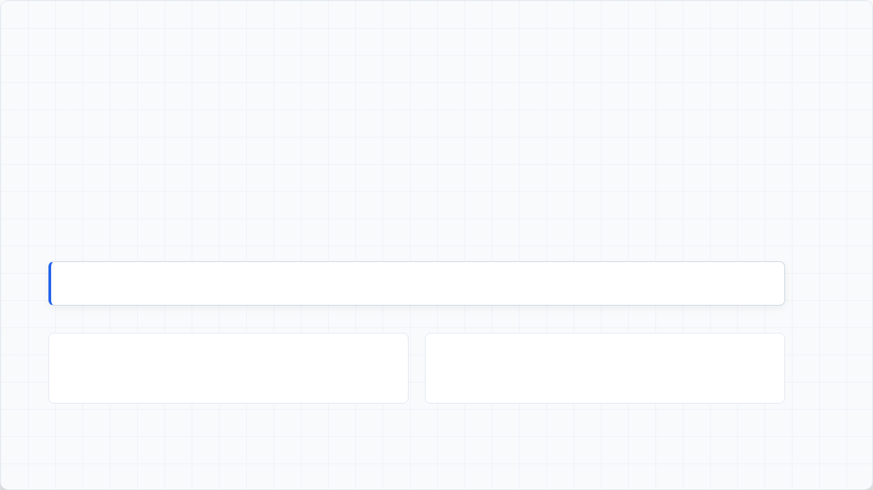
superdesk-sava
One text box for the whole newsroom — Superdesk, driven in plain English.
"Create an article with the headline "This is epic" and publish"
Superdesk has a button for everything. superdesk-sava is one text box that drives them all.
You type what you want; an AI agent executes it directly through Superdesk's real API.

Slide 2







Software is collapsing into a single chat box.
PostHog dashboards "ask your analytics"
Linear issue forms AI agents you assign work to
Intercom ticket queues an AI agent that resolves it
GitHub Copilot / Vercel v0 menus & code describe it, get it
Every software category is moving here.

Slide 3









A natural-language agent wired into Superdesk's API.
Acts as you
Human-in-the-loop
Nothing hardcoded
Never more powerful than the logged-in user. Inherits exact Superdesk permissions.
Publish, spike, and post actions automatically pause for explicit human approval.
Reads each instance's required fields at runtime to fit any Superdesk deployment seamlessly.

Slide 4
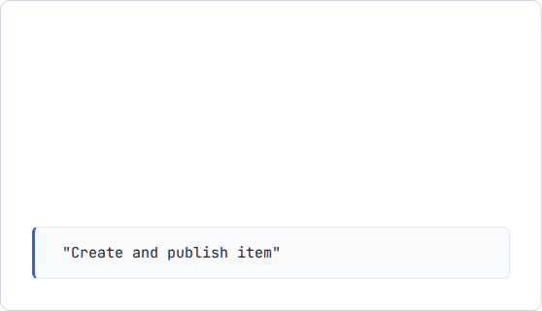








Drive Superdesk & Planning in plain English
Content Discovery & Publishing
Planning & Memory Context
GATE PAUSE

Slide 5


superdesk-sava
Plugs directly into your newsroom workflow, just like superdesk-planning.
github.com/BrianMwangi21/superdesk-sava
Note: To be transferred to the official superdesk GitHub organization

